Slide 1
Airline On-Time Analysis System
Overview
US Airline On-Time dataset, which consists of flight arrival and departure from 1987 to 2008
details are available at Harvard Dataverse Repository.
https://dataverse.harvard.edu/dataset.xhtml?persistentId=doi:10.7910/DVN/HG7NV7
With this project, we want to analyze this dataset and answer questions:
When is the best time of day/day of week/time of year to fly to minimum delays,
Do older planes suffer more delays?
How does the number of people flying between different locations change over time?
Datasets:
Main dataset | The main dataset contains flight date, origin, destination, delay. It includes 22 compress csv files, 120 million rows, 1.6 gb space compressed or 12 gb uncompressed.
Other datasets | It also contains 3 small data set “Airport”, “plane”, “carrier”, each with thousands rows.

Slide 2
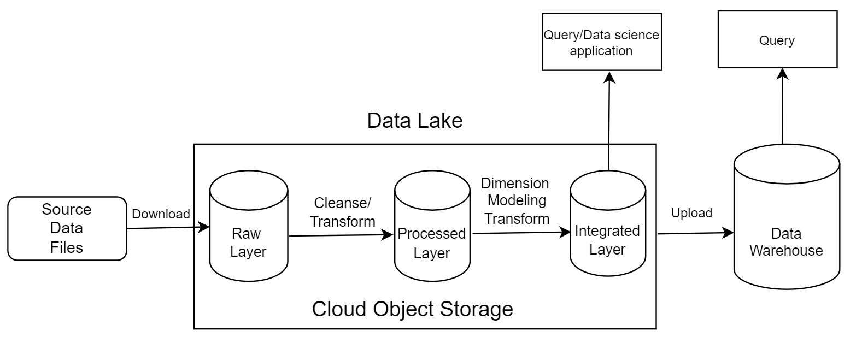
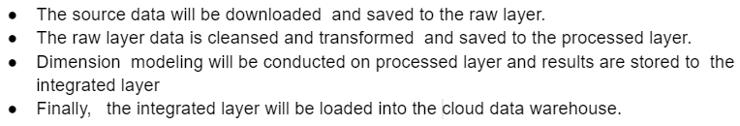
Architecture
Notes:
The data will be stored in 4 different layers (raw, processed, integrated, data warehouse), on cloud or in cloud data warehouse

Slide 3
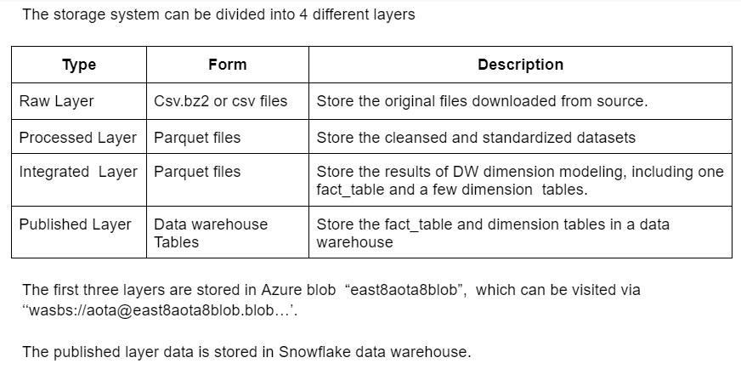
Storage

Slide 4
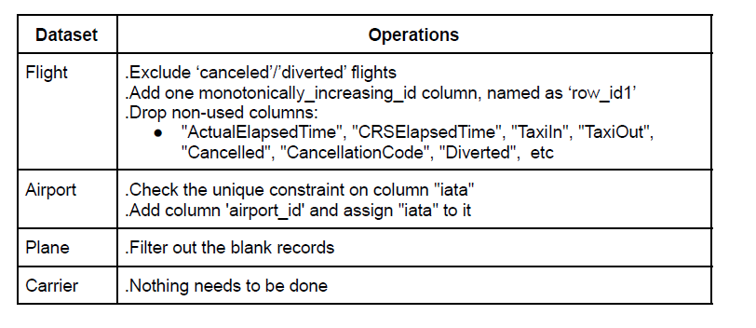
1. ETL process (Cleansing and transformation)
Main process
This process will cleanse and transform the raw data and store the results to the processed layer. Here is the logic:

Slide 5
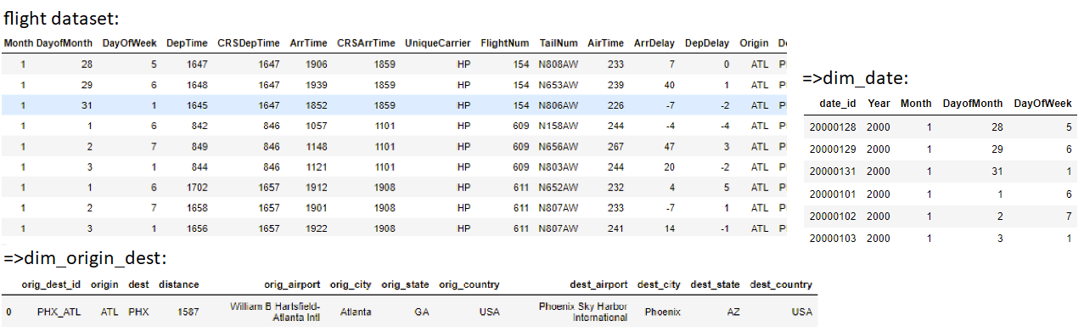
2. Integration (DW Dimension modeling) process
This process will create fact table and dimension tables. The core logic is to create fact table ‘fact_flight’, dimension tables ‘dim_date’ and ‘dim_origin_dest’, based on the flight data set.
In the following example, the 9 sample records from source dataset ‘flight’ will generate 9 ‘fact_flight’ records, 6 ‘dim_date’ records (as it contains 6 unique dates) and 1 ‘dim_origin_dest’ record (as it contains 1 unique origin-destination combination).
Notes:
This process will create fact table and dimension tables. The core logic is create table fac_flight, dim_date and dim_origin_dest based on the flight data set. In the following example, the 9 sample source flight records will create 9 fact_flight record, 6 dim_date records (as it contains 6 unique dates) and 1 dim_origin_dest record (as it contains 1 unique origin-destination combination).

Slide 6
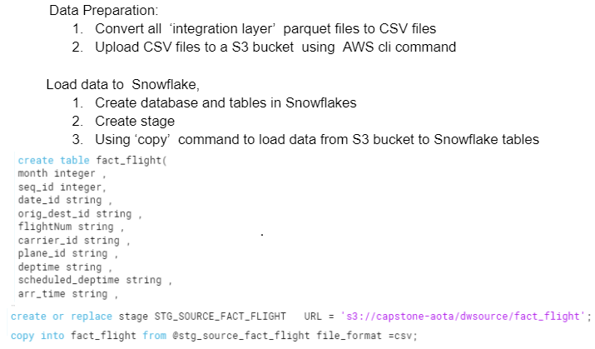
3. DW-ETL process: this process is to load data from the integrated layer to Snowflake. Steps:

Slide 7
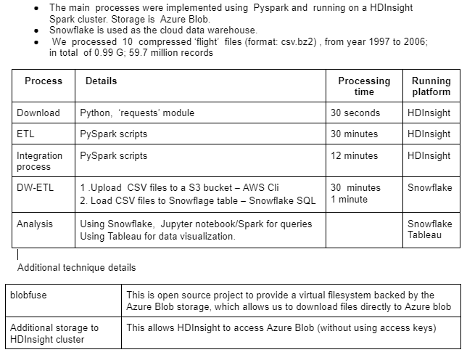
Implementation and run

Slide 8
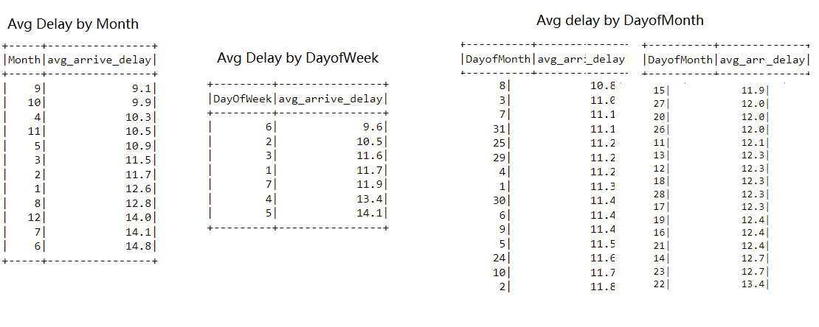
Question: When is the best time of day/day of week/time of year to fly to minimum delays?
Analysis: Finally, we ran queries on the published layer (Snowflake tables) or integrated layer (parquet files) to get answers to our questions. Arrival-delay is used and negative values have been converted to 0.
Answer: Above are the average delays in minutes against month, DayofWeek and DayofMonth. We can see: the best month is September; best day of week is Saturday; best day of month is 8th.

Slide 9
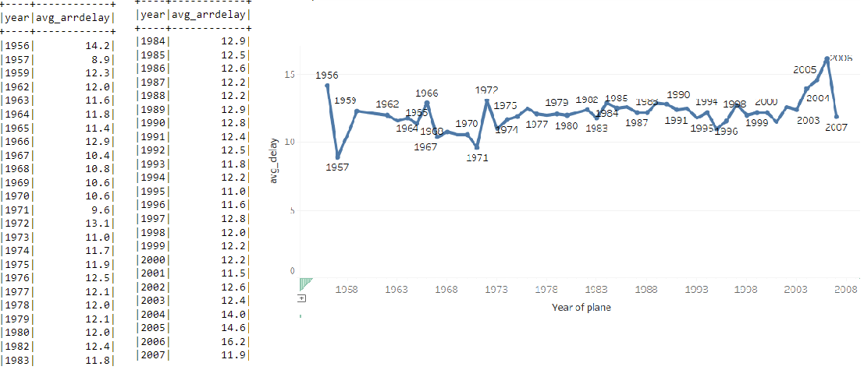
Question: Do older planes suffer more delays?
Answer: Below are the average delay against year of the planes. We can see the older planes don’t suffer more delays.

Slide 10
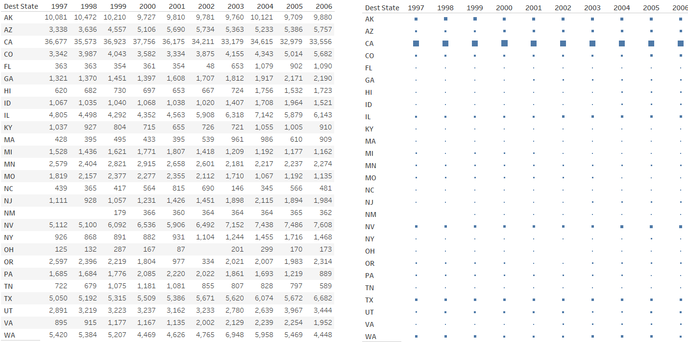
Question: How does the number of people flying between different locations change over time?
Answer: Below are number of flights departing from Seattle to different states over 10 years. We can see for some states, the number has increased significantly, such as IL, NV, FL. GA, etc; for some, it has not, such as AK, CA, WA.

